Slide 1
Racism Against Minorities in New York City
Gabriella Vaitzman
Karina Salas
Helen Ogunleye
Diane Bazar

Slide 2
What is Race?
Race refers to a group of people that share some socially defined physical characteristics like skin color, hair texture, and even facial features
This is commonly referred to as a “social construct”
Society has created a superior and inferior culture, where one group deem themselves dominant over another. It perpetuates hate, violence, and fear to those who are considered the minority groups.
When walking into a room, one might think it’s easy to determine someone’s race/ethnicity based on looks. This becomes problematic because many are ambiguous in physical features.

Slide 3
Science and Racism
In earlier decades, scientists have tried to prove the inferiority of blacks and superiority of whites through specific testing.
Scientists wanted to see if this “inferiority” and “superiority” was nature v. nurture.
Phrenology was one of the methods used for this testing that compared skull sizes of different racial groups. These findings were then used to try to determine intelligence and innate group differences.
Ignorant tests like this, gave birth to idea of the extinction thesis. This thesis compared mortality rates in infants within white and black communities.
There was a higher infant mortality rate amongst black communities due to socioeconomic factors, but that was harshly overlooked.
Scientists believed that public or social investment into these communities were worthless because it was a “dying race”
Arrogance of such “studies” created the divide within society, leading to a mindset of superiority

Slide 4
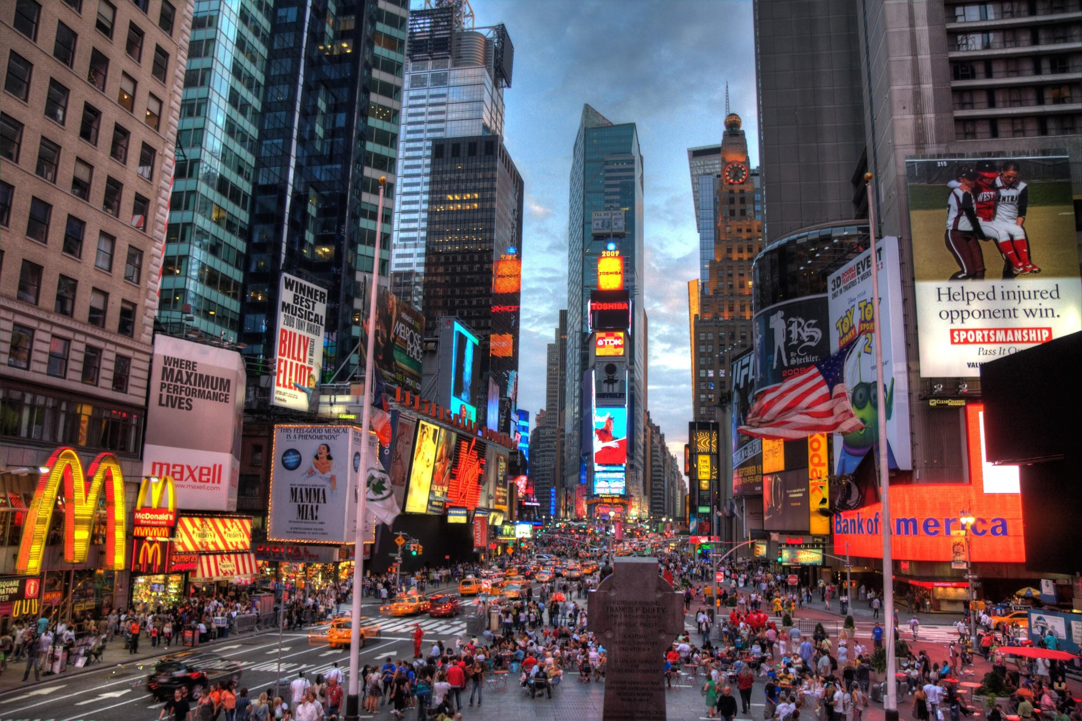
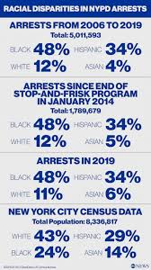
Racism in New York
Despite there being current progress in the alleviation of racial tension, hateful efforts have tried to put a halt to this.
According to the F.B.I., hate crime reports increased 17 percent from 2016, rising as heated racial rhetoric and action dominate the news.
Nearly 3 out of 5 hate crimes were motivated by race and ethnicity
Many hate crime victims do not trust the police and do not feel comfortable reporting a crime committed against them.
New Yorker’s describe racism as “inescapable and emotionally taxing” due to their constant racist experiences in everyday life ranging from school, employment, healthcare, and housing

Slide 5
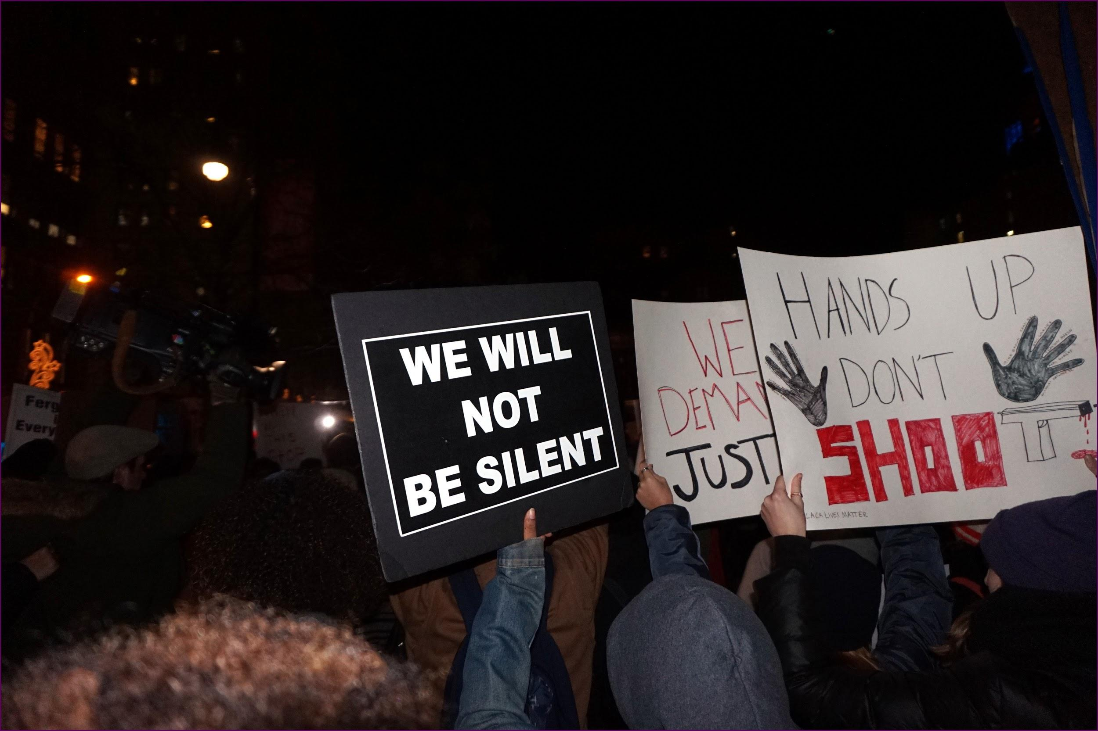
The Story of Eric Garner
Eric Garner was a 400lb man with pre-existing health conditions
He was confronted by the police while selling unlicensed cigarettes, thus leading to his arrest
Nonviolently, Garner started to resist arrest. Due to the fact that Garner was a known criminal in the system, NYPD considered him a threat.
The arresting officer, Officer Palento, put Garner in a chokehold along with three other officers physically grabbing him
Garner fell to the floor with Palento’s arm still around his neck
Complaining that he couldn’t breather, Garner died an hour later from compression of neck and chest.
This put Officer Palento at fault because he triggered Garner’s already existing health condition while using a banned NYPD technique of a chokehold.

Slide 6
COVID-19, Racism, and the NYPD
NYPD officers have been enforcing social distancing rules that fueled complaints that there was unfair targeting of black and Latino residents
This was considered an illustration of a racist double standard for social distancing
It mirrored the “stop & frisk” policy
The police released data on summonses and arrests revealing more than 90% of people arrested and 82% of those who received summonses related to COVID-19, have been black or Hispanic.

Slide 7
Racism VS. Racial Profiling
•Racism causes people to have a certain stereotype against others and treat them as they are inferior. Due to this way of thinking, people begin to conjure up hate in their hearts for people who look differently than them. This is called prejudice.
•Racism is most common against African Americans, Latinos, Asians, and more.
•Racial profiling happens when someone considers a specific race or ethnic group a threat or criminal. It is the intentional targeting of people due to their race.

Slide 8
“Trump supporter calls 911 on black Lyft driver for not turning on the radio”
•Robert Ortiz a Trump supporter and his partner were passengers in Pepas Lettman car. Pepas Lettman is an African American Lyft driver. He asked the driver to play music, but Lettman did not want to play music in his car.
•Ortiz called the police and told them that Lettman did not want to play music in his car “because we are gay.” He also told them that if they were black than Lettman would have turned on the radio.
•Those passengers were racist, rude, and disrespectful. They called Lettman derogatory name and used abusive language. They started problems and harassed Lettman because of his skin color. The Lyft driver kept his composure and ignored them.

Slide 9
COVID-19 And Racial Inequalities
•COVID-19 has revealed the inequalities in the system and how race is a factor in terms of peoples economic and health. There is a disproportionate representation of people of color who are essential workers. Many of them work for smaller pay than whites and they do not have adequate healthcare.
•In the number of people who unfortunately passed away, African Americans and Latinos died in much greater percentage and that can be traced back to the racial inequalities in society. Many people of color who work these low wage jobs do so at the risk of their own health. Up to today, America do not have an adequate health care system that covers everyone. There are many people of color who either do not have health insurance or cannot afford it.
•Health care is a controversial issue when it really should not be. America owes it to all its citizens such as blacks, whites, brown, and more to provide for all. However, race is so deeply embedded in the American society.
•Healthcare and economics are influenced by a person’s race. Therefore, it is argued by many that race is a system that institutionalized and systematic in the American society.

Slide 10
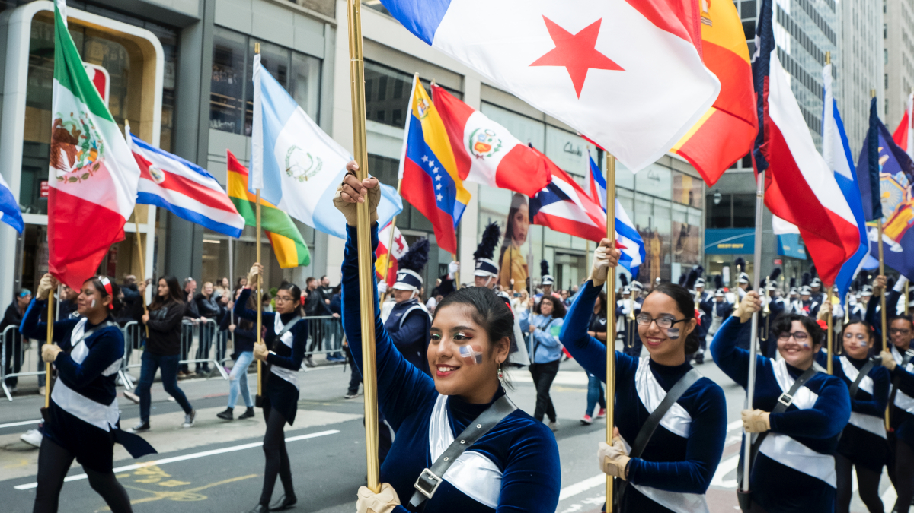
Discrimination against Hispanic and Latinx Communities

Slide 11
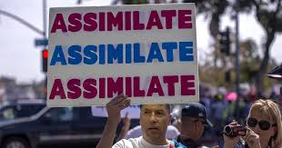
Hispanic and Latino Americans in the U.S
According to PEW research, Hispanics are the nation’s second-fastest-growing racial or ethnic group after Asian Americans.
Overall, about a quarter of Latinos (24%) say someone has discriminated against them or treated them unfairly because of their background
22% say someone has criticized them for speaking Spanish in public.
About 20% say they have been told to go back to their home country, and about
16% say they have been called offensive names.

Slide 12
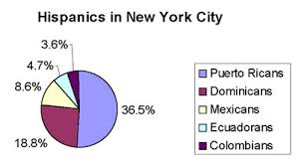
HISPANICS IN NEW YORK
The Hispanic population in New York is the fourth largest in the nation.
About 3.7 million Hispanics reside in New York, 6.6% of all Hispanics in the United States.
According to the US Census Hispanics make up 29.1 percent of the population in New York City

Slide 13
Victims of Segregation in NYC
According to a study done by the University of Albany, the Hispanic and Asian populations in New York City had grown since have grown steadily, but since 1980, there has been little improvement in their level of segregation.
In 2010, 48 percent of the residents in Hispanic neighborhoods were from the same culture
Even though it is not explicitly stated landlords gatekeep their communities by denying housing to certain tenets
Hispanics experience significant levels of racial discrimination in the rental housing market, according to a new study. Compared to whites, they are 28 percent less likely to have a landlord return their calls and 49 percent less likely to receive an offer at all. (Princeton University)
Notes:
https://wagner.nyu.edu/files/publications/Pamphlet_Racial_Inequality.pdf

Slide 14
Example of Discrimination against Hispanics
In 2018, an affluent NYC lawyer, Aaron Schlossberg discriminated and disrespected two employees of a in a Manhattan restaurant for speaking Spanish.
In the viral video posted by Emily Serrano, a Puerto Rican woman from the Bronx, he states, “My guess is they’re not documented, so my next call is to ICE to have each one of them kicked out of my country...If they have the balls to come here and live off my money — I pay for their welfare. I pay for their ability to be here. The least they can do — the least they can do — is speak English.” (CBS News)
Rhetoric like “go back to your country” and “speak English” are commonly used to discriminate against and disrespect people of hispanic heritage.
NYC prides itself as being a diverse city but instances of racism and discrimination are still common and minories are commonly viewed as second class citizens compared to their white counterparts

Slide 15
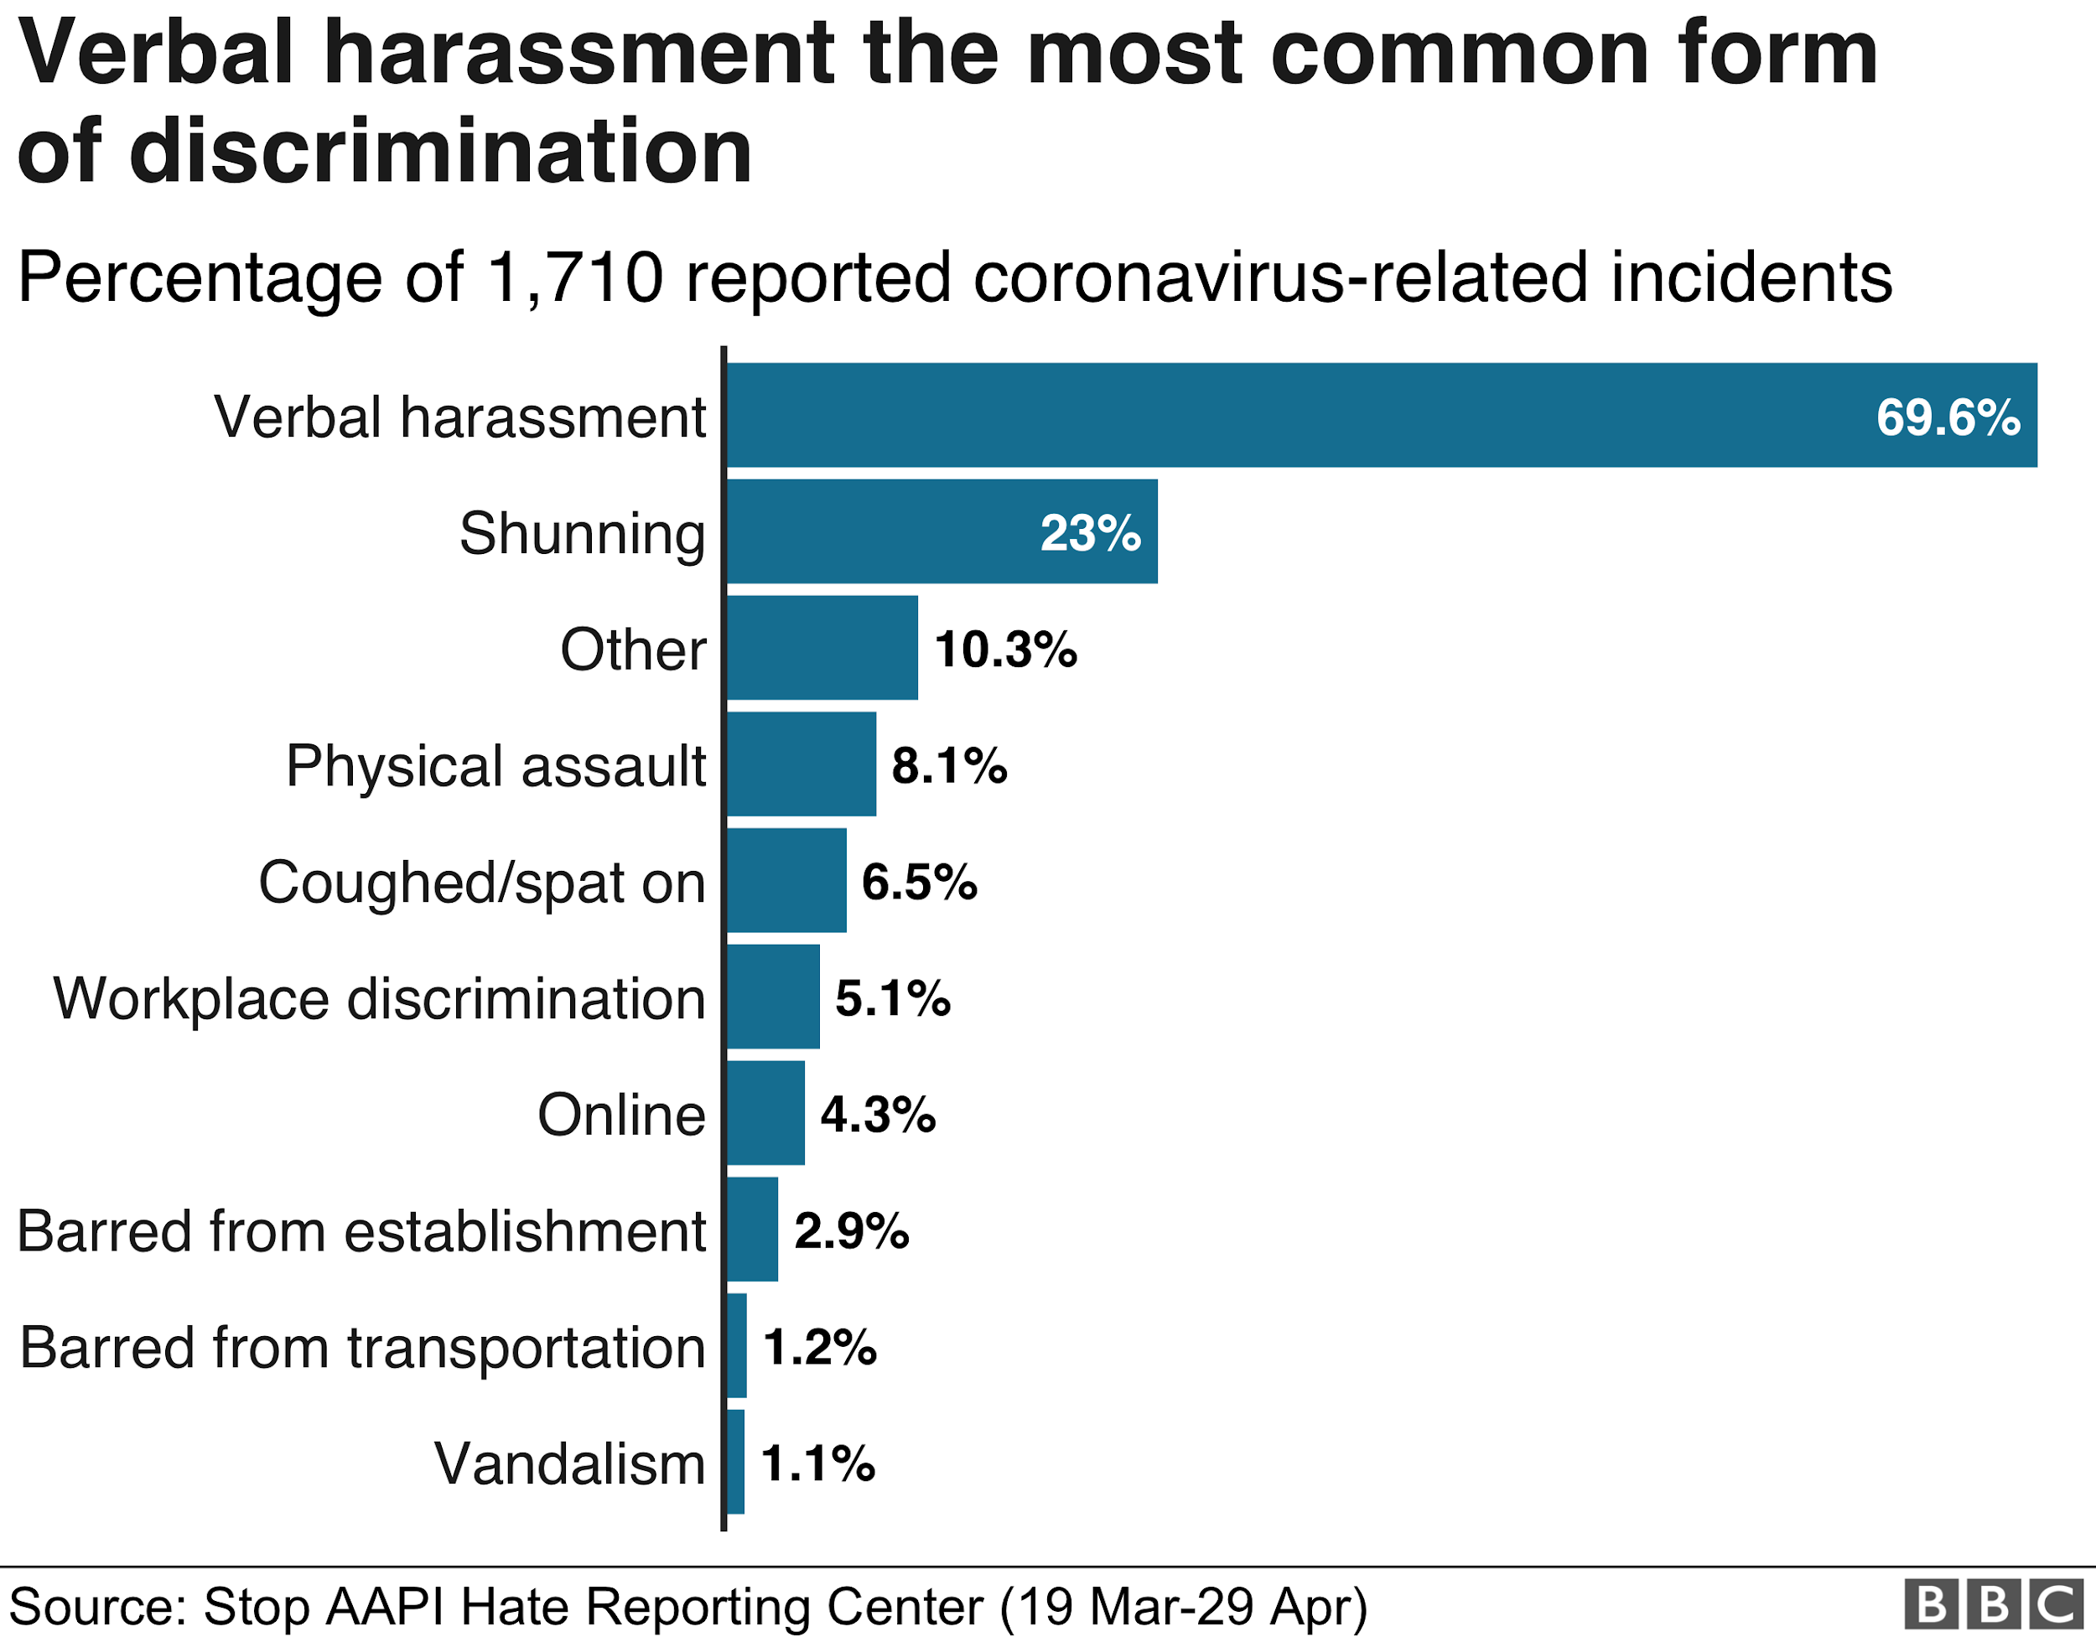
Racism Against Asian Minorities with the Spread of COVID-19
The 2020 year has been chaotic for many people in the United States, but there have been more difficulties for some people than others, especially minorities.
Due to the COVID-19 epidemic, there was a lot of retaliation against the Asian population.
People from the Asian communities suffered high levels of hate crimes, and violent acts went up to more than 100 per day.
Karina Salas

Slide 16
Racism against Asian minorities and Media during COVID-19
Media is one of the most potent resources people have used to communicate with others, especially during the pandemic. However, it has also been a powerful tool to spread hate and fear in society.
A study showed that media platforms like Facebook, Twitter, Instagram, and others had spread false news and covered discrimination and xenophobia in the last years. Phrases like “Chinese virus,” “Kung Flu,” or words that advise people to stay away from Asian communities have raised the level of anxiety in others and lead them to act differently with them.
Karina Salas

Slide 17
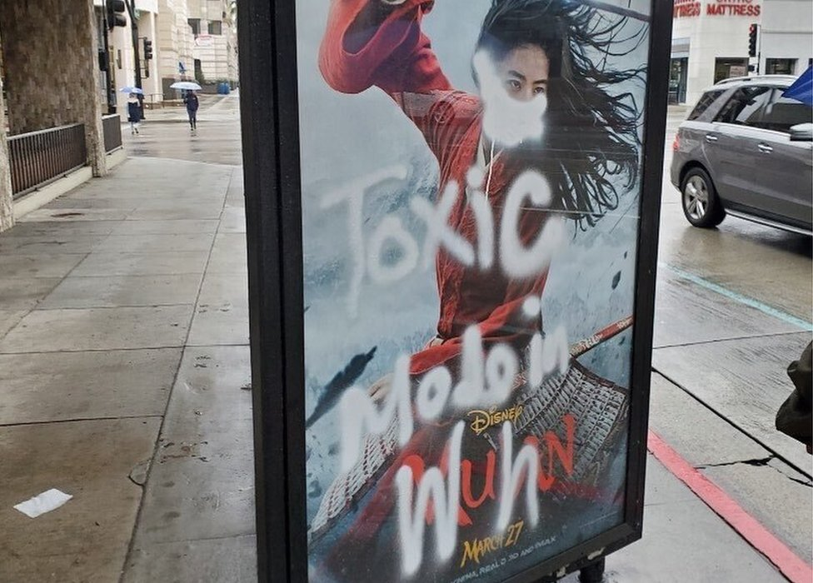
Results and Analysis
After analyzing data responses from 274 participants, Croucher, Nguyen, & Rahmani determined some essential things that the study revealed.
Women are more likely to feel threatened due to their pressure when they see social media news. They present a defensive attitude towards others to avoid bad feelings and possible offenses.
Self-esteem has a connection with intergroup anxiety because depending on the amount of time spent on social media, there is an effect on others' interaction.
Finally, depending on the social media used, there can be a higher impact on self-esteem and anxiety levels.
Karina Salas

Slide 18
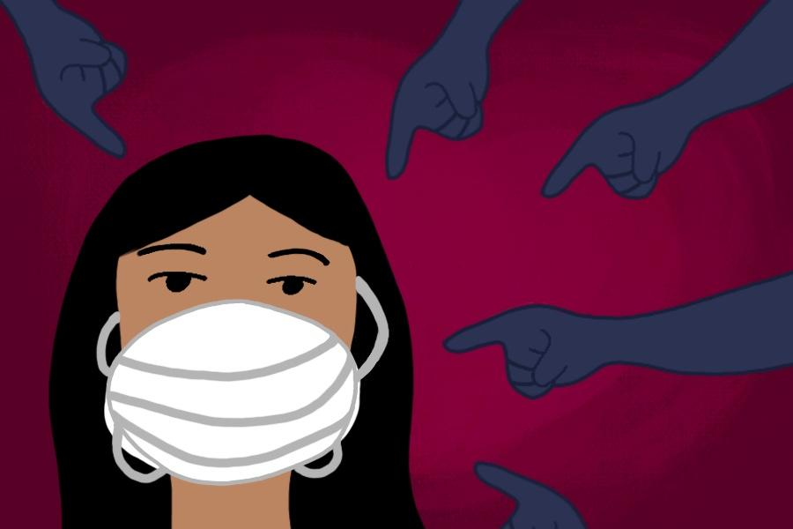
Racism against Asian minorities in Brooklyn due to COVID-19
After the pandemic was made public, and President Donald Trump referred to it as the “Chinese Virus,” many accidents started to occur in different States in the country. New York was one of the states where it was very present.
There were accidents reported in Manhattan, Queens, The Bronx, and Brooklyn.
In Brooklyn, a 26 years old Asian man reported being attacked in the subway by a man and accused him of being part of the virus and spreading it.
Karina Salas

Slide 19
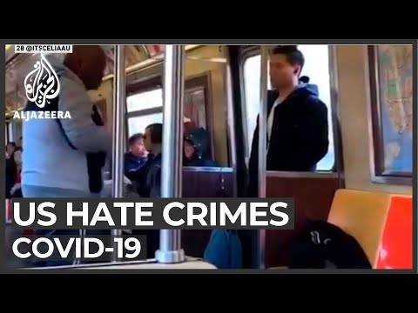
Hate incidents against Asian communities
This video shows some of the incidents that happened during the pandemic and how it has changed different people's lives.
Karina Salas
Notes:
https://www.youtube.com/watch?v=9siwWlAuNGE

Slide 20
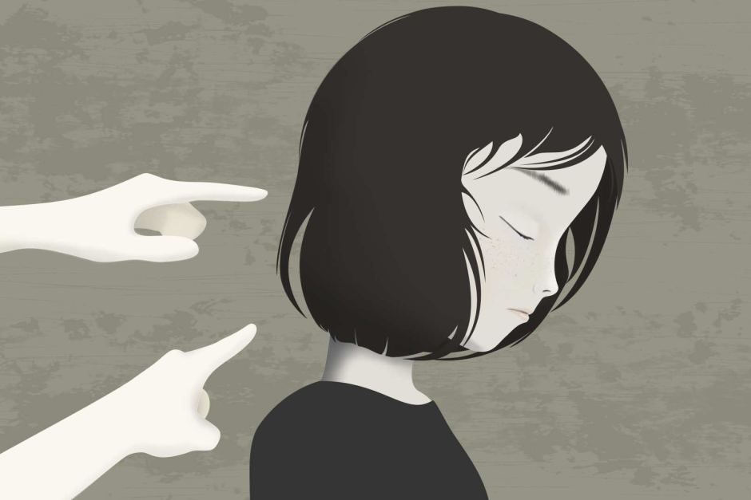
Psychological Effects of Racism
Racism as a whole can cause anxiety, fear, and different traumas that can lead to significant changes in the life of a person. However, the fact that we are going through a pandemic affects even more Asian people. Asian communities not only have to worry about their health because of the virus. They have to worry about their wellbeing due to the threats they receive every day.
Karina Salas

Slide 21
Discussion
Racism during the COVID-19 pandemic is a vital topic to educate others and make them aware of the problem causing minorities like Asian communities. It is essential to address the issue to find solutions and work together and not separate communities to end discrimination and racism. The level of attacks on Asian communities has affected them physically due to violence in the attacks and psychologically. The social aspects of life in New York City from studying racism against minorities show that there are people from all over the world in NYC, and when they come to this country, they practice their cultures, which makes the country prosperous. However, many people believe that American culture must be the primary culture and forget their cultures.
Karina Salas

Slide 22
References
Bowser, Benjamin P., Chelli Devadutt. “Racial Inequality in New York City Since 1965”. 2019. PDF
Brito, Christopher. “‘I Am Not a Racist’: NYC Lawyer Who Went on Viral Rant against Spanish-Speaking Workers Apologizes.” CBS News,CBS Interactive, 23 May 2018, www.cbsnews.com/news/nyc-lawyer-aaron-schlossberg-who-went-on-racist-rant-against-spanish-speaking-workers-apologizes-fresh-kitchen/.
Croucher, S., Nguyen, T., & Rahmani, D. (2020, May 22). Prejudice Toward Asian Americans in the Covid-19 Pandemic: The Effects of Social Media Use in the United States. Retrieved December 07, 2020, from https://www.frontiersin.org/articles/10.3389/fcomm.2020.00039/full
FITZGERALD, KATHLEEN J. RECOGNIZING RACE AND ETHNICITY: Power, Privilege, and Inequality. ROUTLEDGE, 2020.
Gover, A.R., Harper, S.B. & Langton, L. Anti-Asian Hate Crime During the COVID-19 Pandemic: Exploring the Reproduction of Inequality. Am J Crim Just 45, 647–667 (2020). https://doi.org/10.1007/s12103-020-09545-1
Kelly, Rose B. “Hispanics Face Racial Discrimination in New York City” Princeston Univeristy, The Trustees of Princeston Univerity, www.princeton.edu/news/2018/10/24/hispanics-face-racial-discrimination-new-york-citys-rental-housing-market.
Krogstad, Jens Manuel, and Luis Noe-Bustamante. “Key Facts about U.S. Latinos for National Hispanic Heritage Month.” Pew Research Center, Pew Research Center, 10 Sept. 2020 www.pewresearch.org/fact-tank/2020/09/10/key-facts-about-u-s-latinos-for-national-hispanic-heritage-month/.
.

Slide 23
References Continued
Eligon, John. “Hate Crimes Increase for the Third Consecutive Year, F.B.I. Reports.” The New York Times, The New York Times, 13 Nov. 2018, www.nytimes.com/2018/11/13/us/hate-crimes-fbi-2017.html.
Lopez, Mark Hugo, et al. “Latinos' Experiences with Discrimination.” Pew Research Center's Hispanic Trends Project, Pew Research Center, 27 Aug. 2020, www.pewresearch.org/hispanic/2018/10/25/latinos-and-discrimination/.
Pinkhasov, Miriam, et al. “Eric Garner.” Race, eportfolios.macaulay.cuny.edu/raceinnyc/eric-garner/.
Scotto, Michael. “New Report Finds Racism Is 'Inescapable' in New York City.” Spectrum News NY1, 10 June 2020, 8:44 PM, www.ny1.com/nyc/all-boroughs/news/2020/06/11/new-report-finds-racism-is--inescapable--in-new-york-city.
Sole, Elise. “Trump Supporter Calls 911 on Black Lyft Driver for Not Turning on the Radio.” Yahoo! News, Yahoo!, 11 Oct. 2018.
Southall, Ashley. “N.Y.C. Commissioner Denies Racial Bias in Social Distancing Policing.” The New York Times, The New York Times, 13 May 2020, www.nytimes.com/2020/05/13/nyregion/nypd-social-distancing-race-coronavirus.html.

